Slide 1











System administration
Group: 20-Sys

Slide 2
Installing and configuring DNS, DHCP, Domain Controller on Ubuntu Server
Student: Amil Jamilov
Instructor: Ulvu Feyziyev

Slide 3
Plan:
Installing Ubuntu Server,
Initial network settings
01
DNS, DHCP, NAT installation, adjustment
02
Domain Controller installation, adjustment
03
NFS Server, GNOME Desktop Environment, Docker Container Platform
04

Slide 4



Slide 5
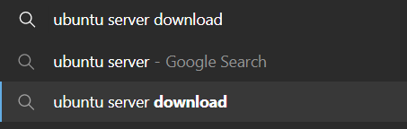
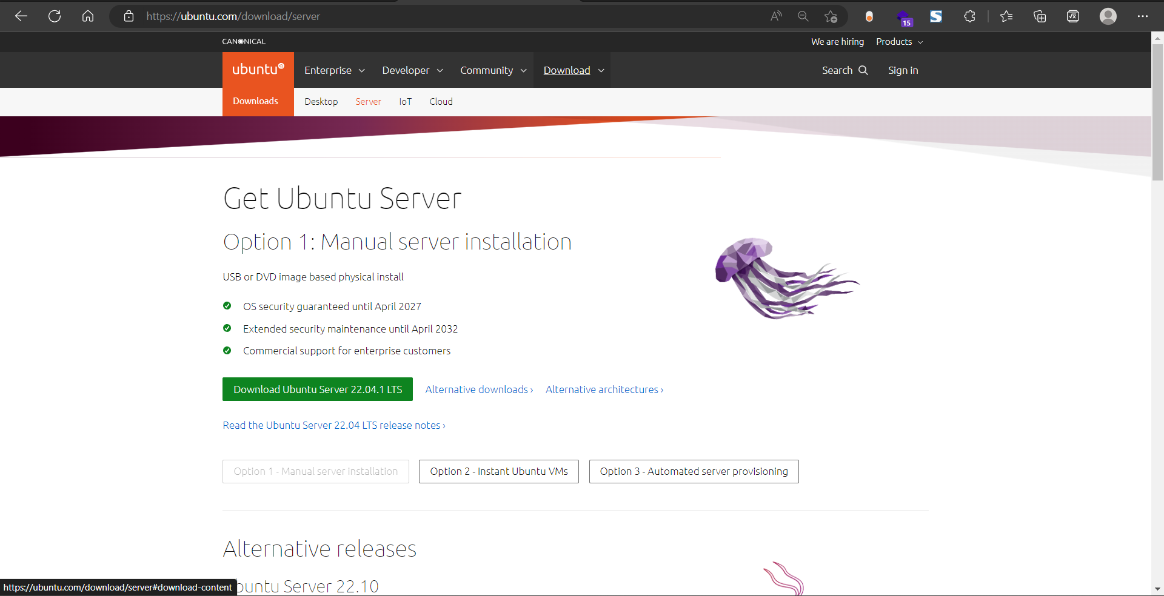

Slide 6
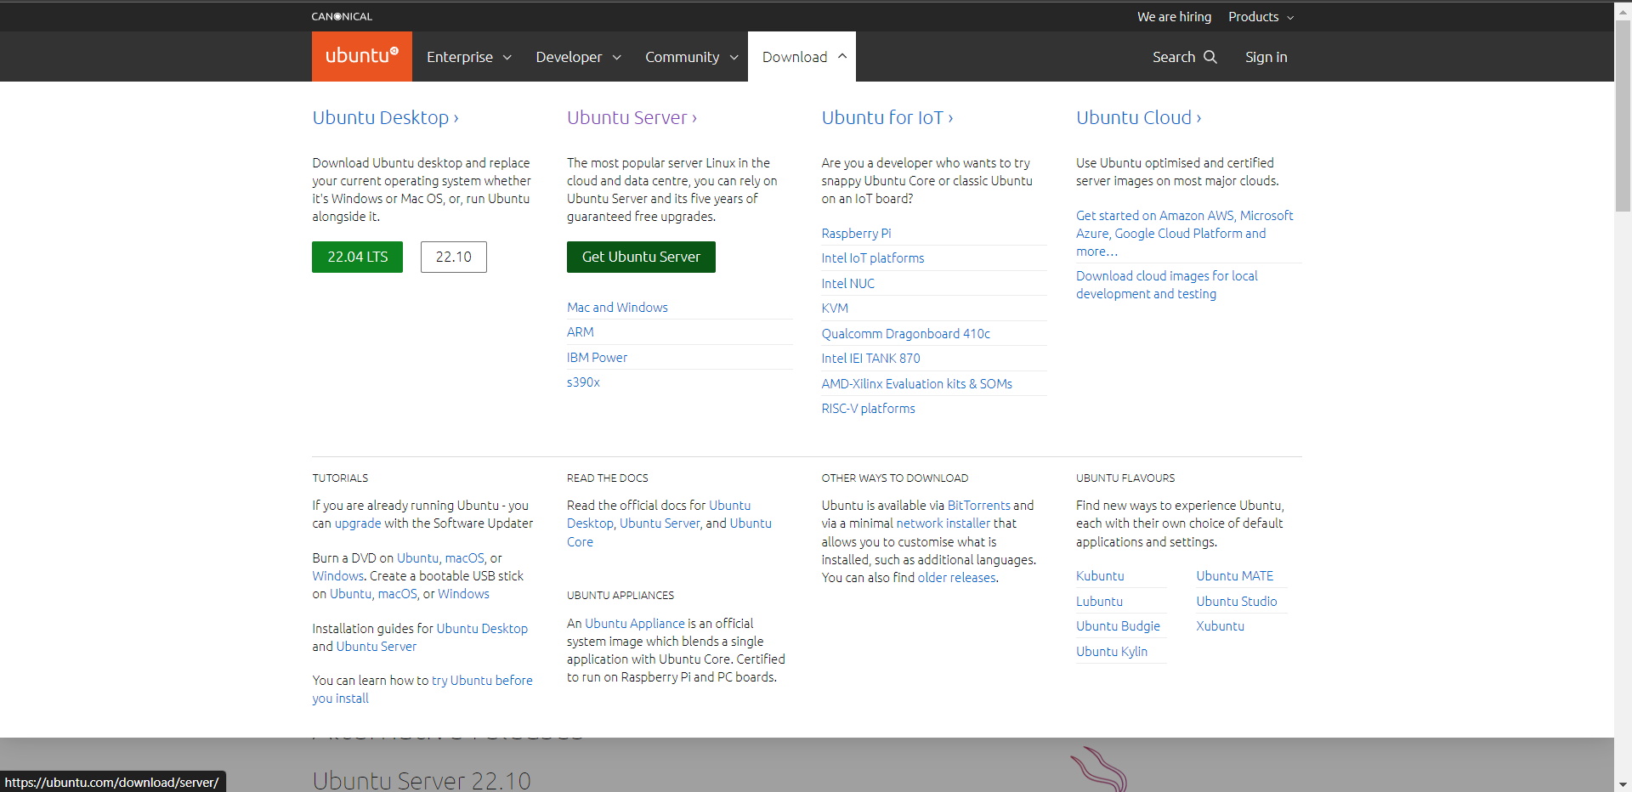


Slide 7
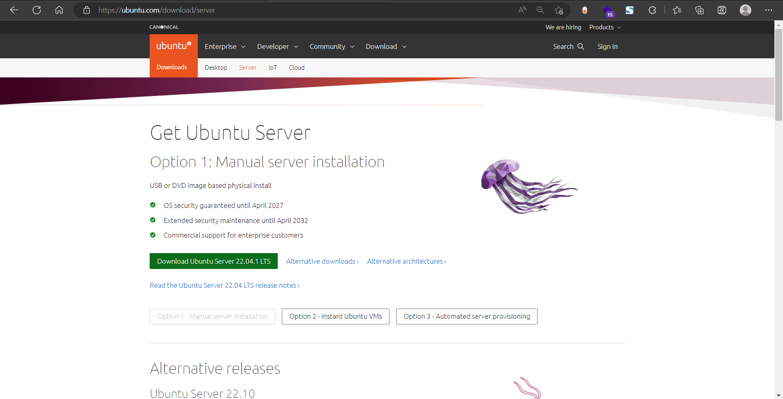

Slide 8
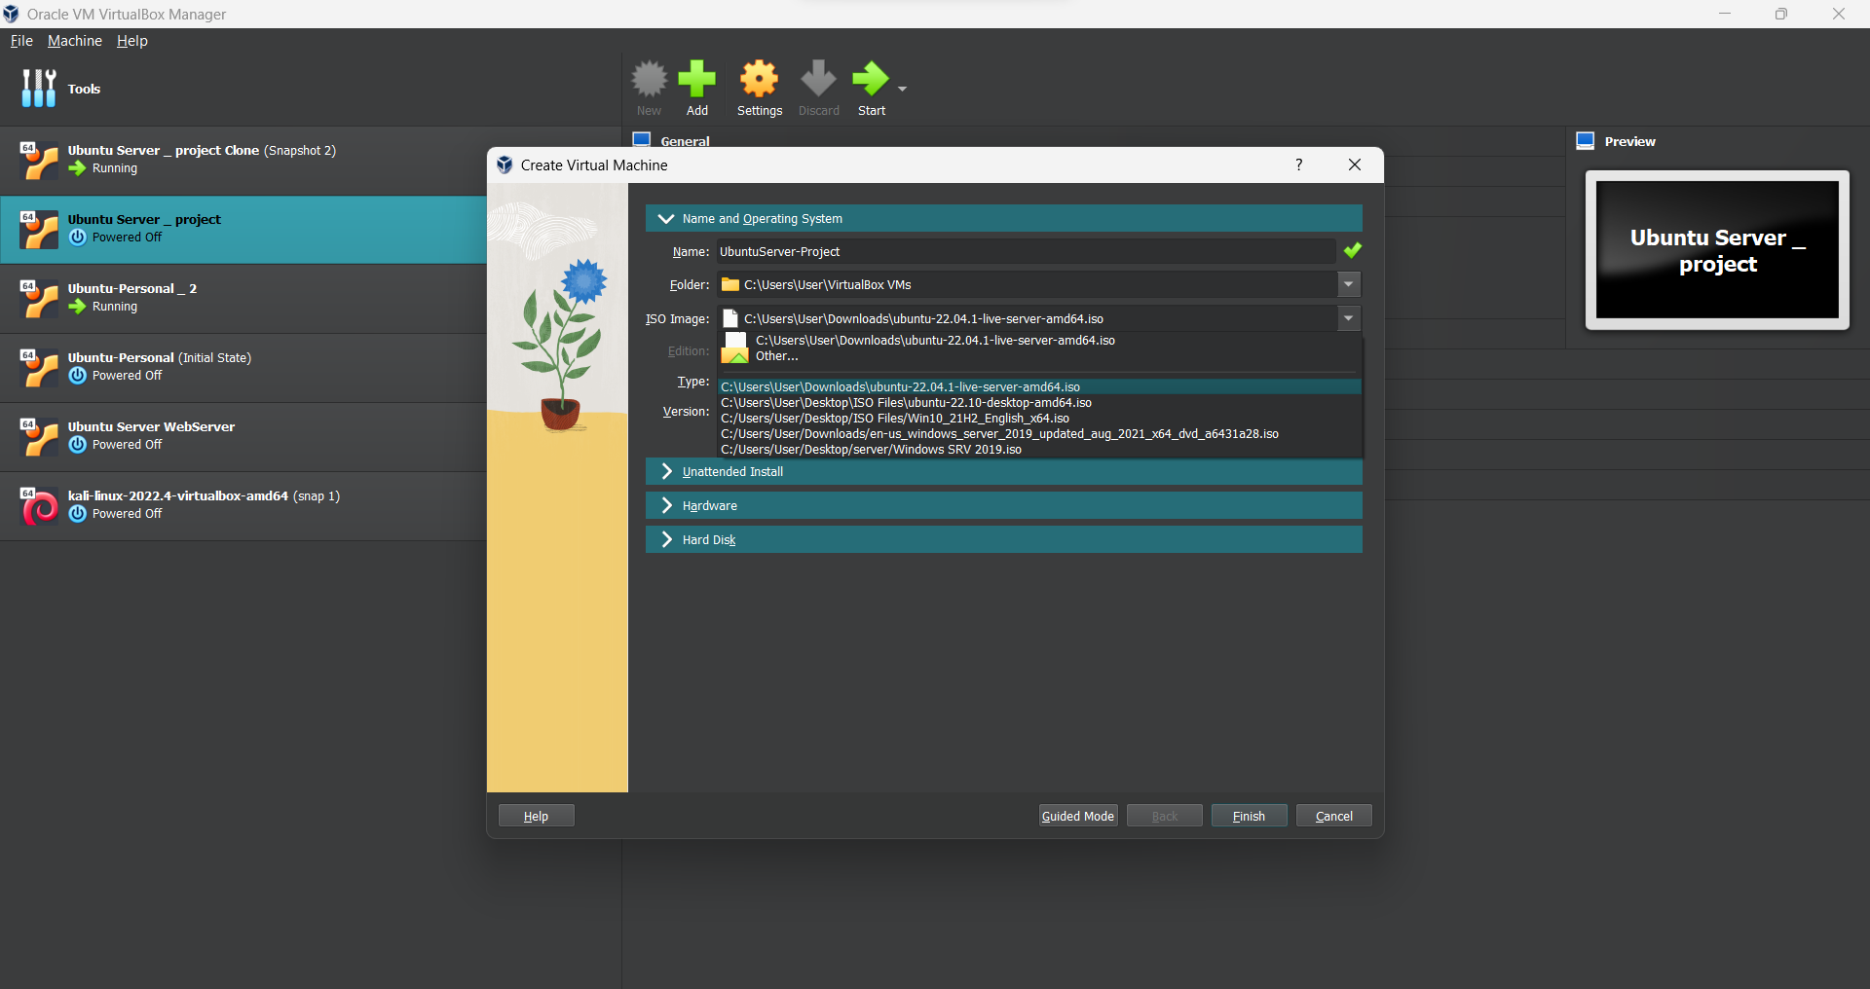

Slide 9
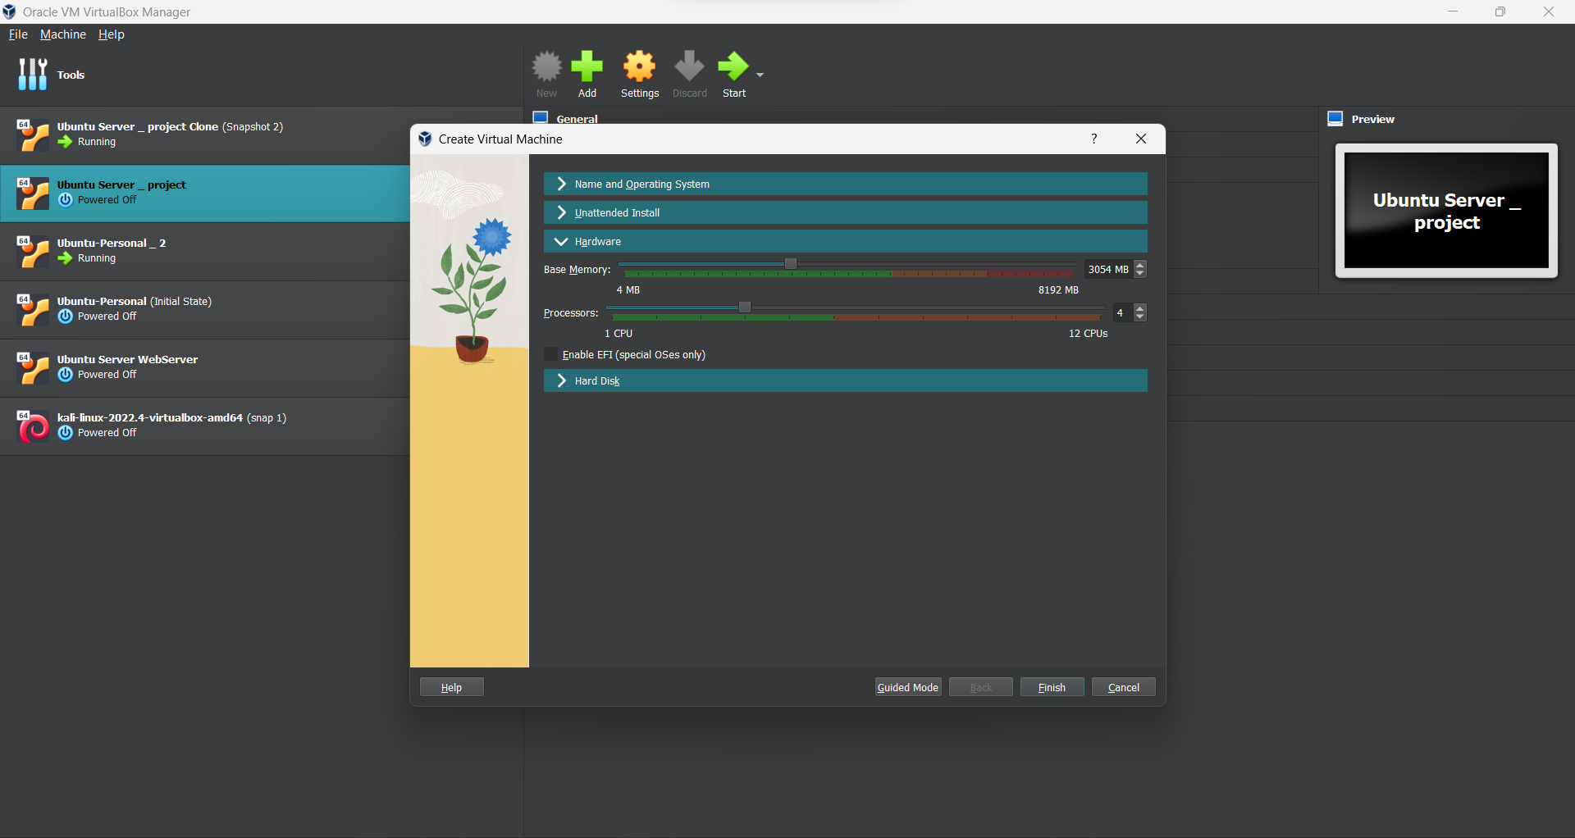

Slide 10
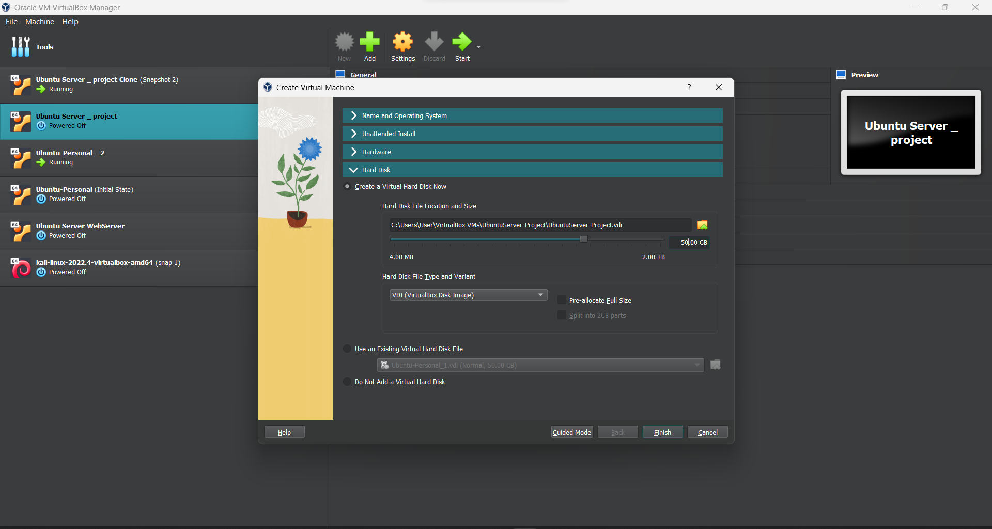

Slide 11
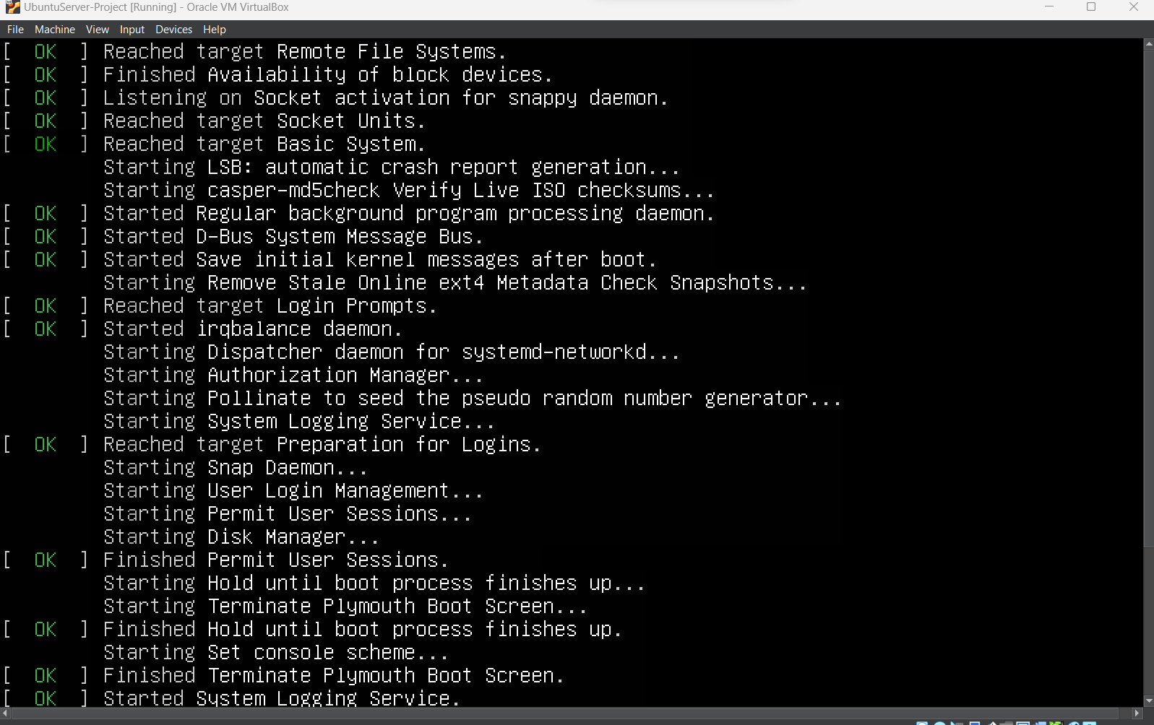

Slide 12
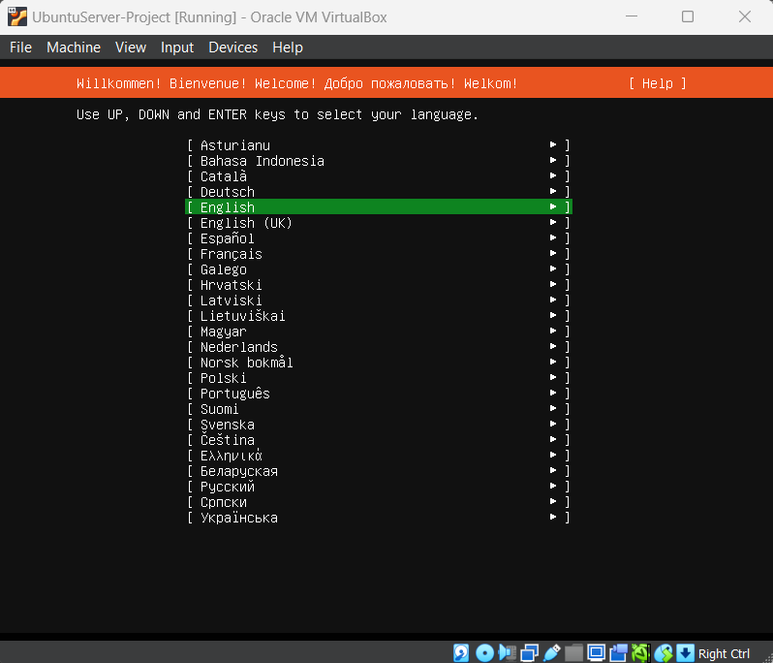
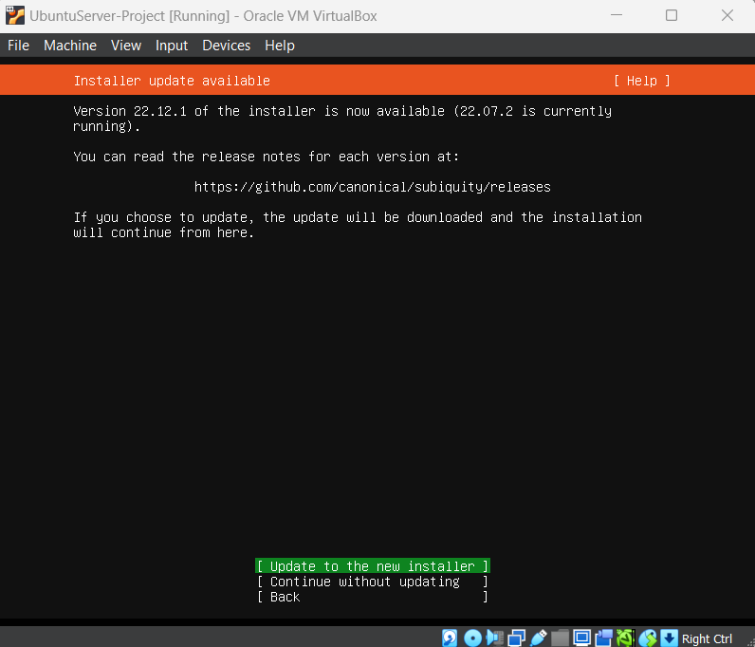

Slide 13
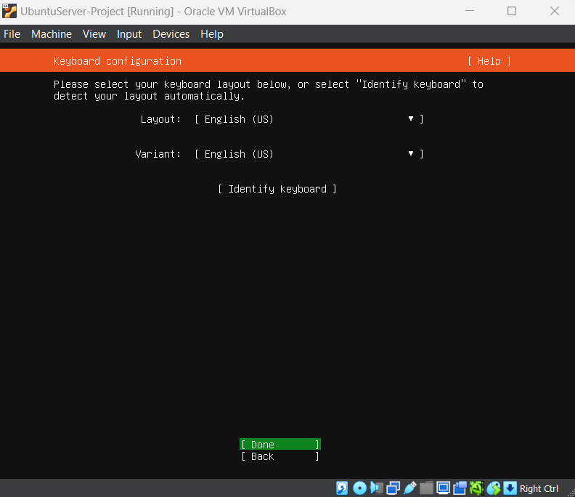
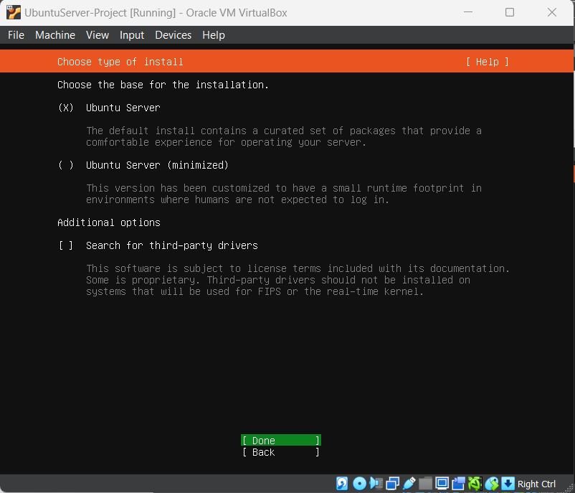

Slide 14
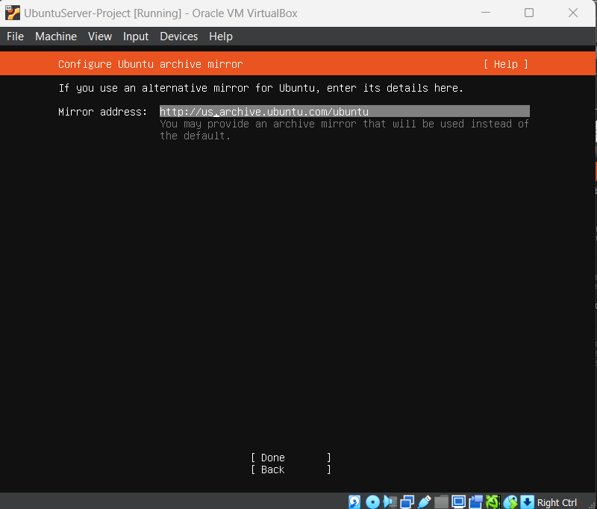
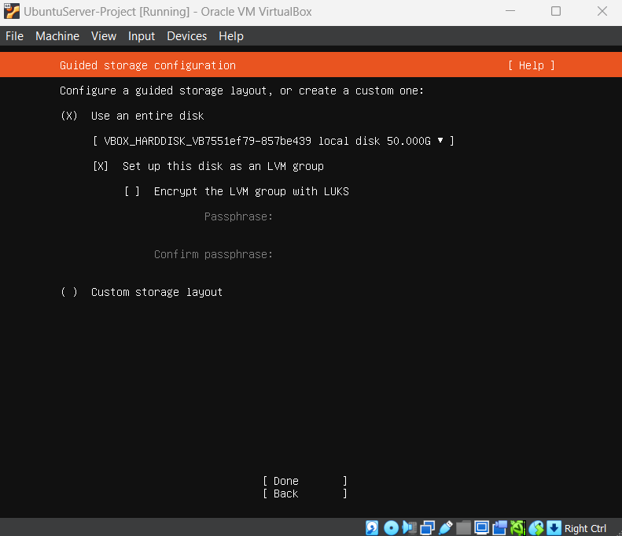

Slide 15
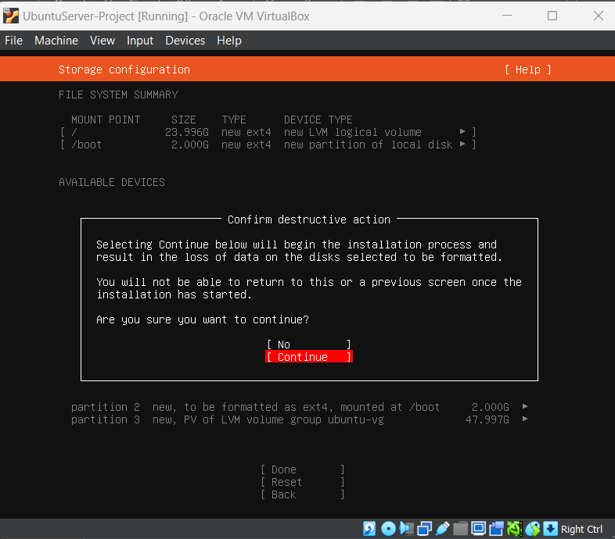
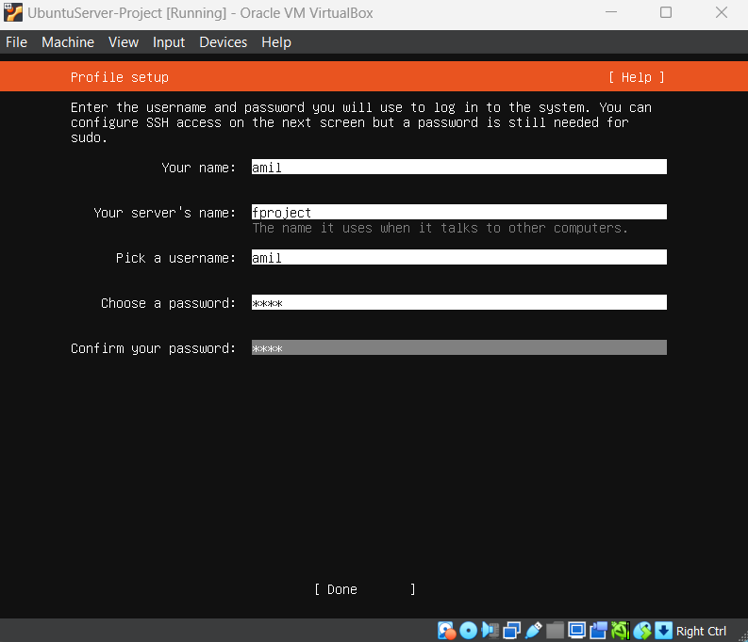
0011

Slide 16
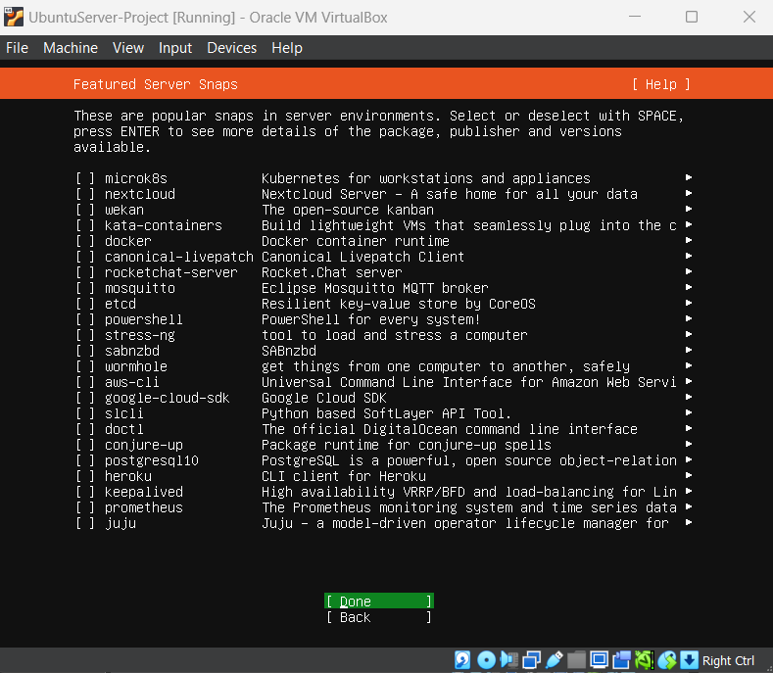
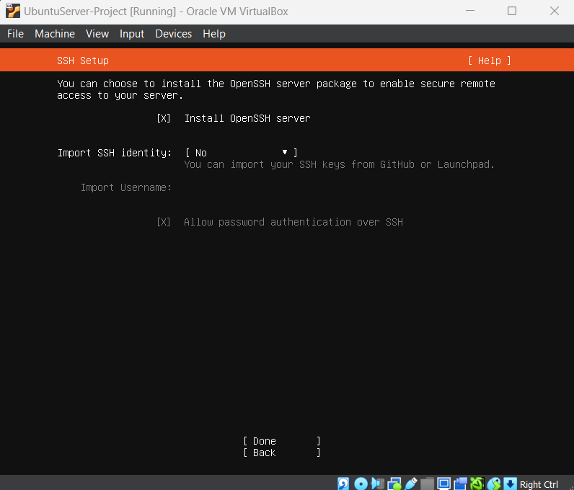

Slide 17
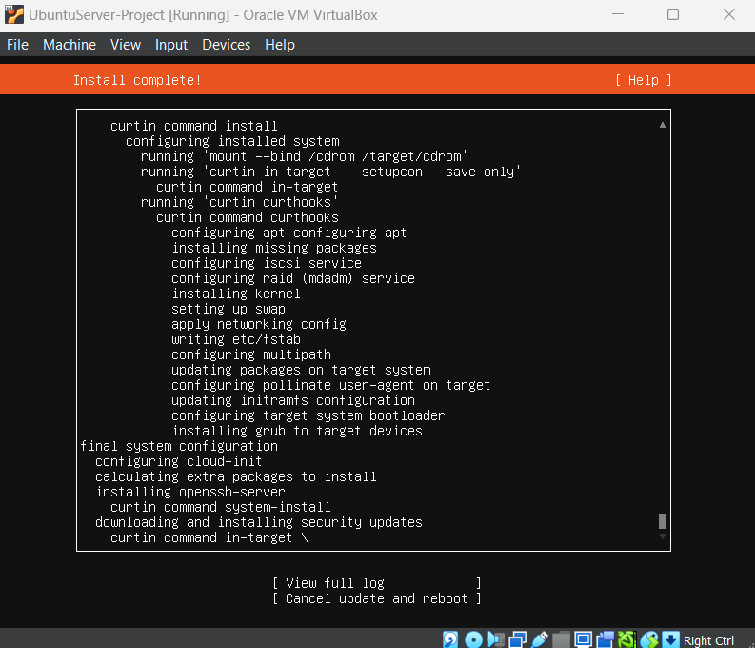

Slide 18
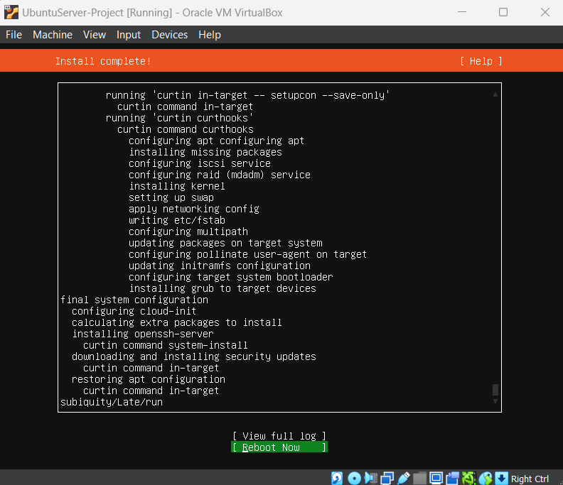
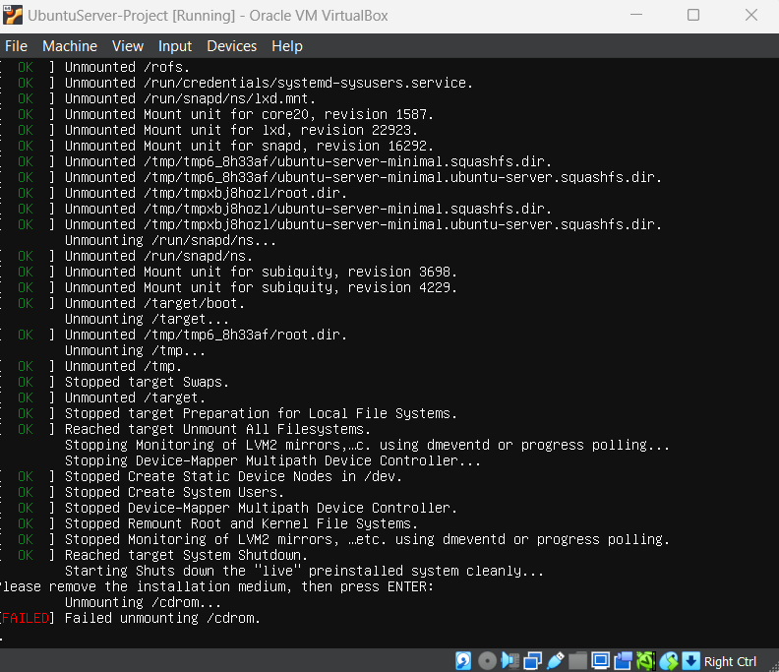

Slide 19
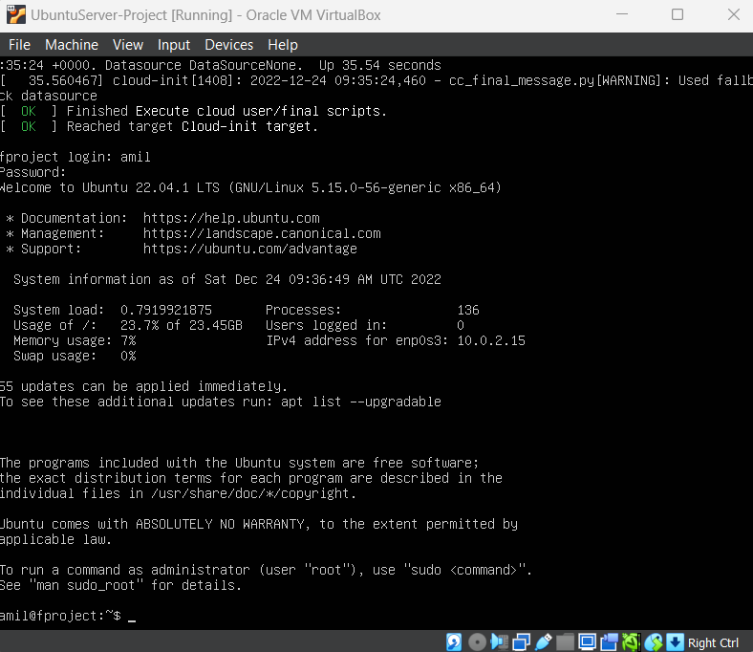
System is ready!

Slide 20
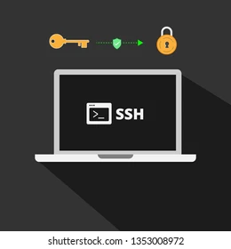
Network setup, connecting to the server via SSH

Slide 21
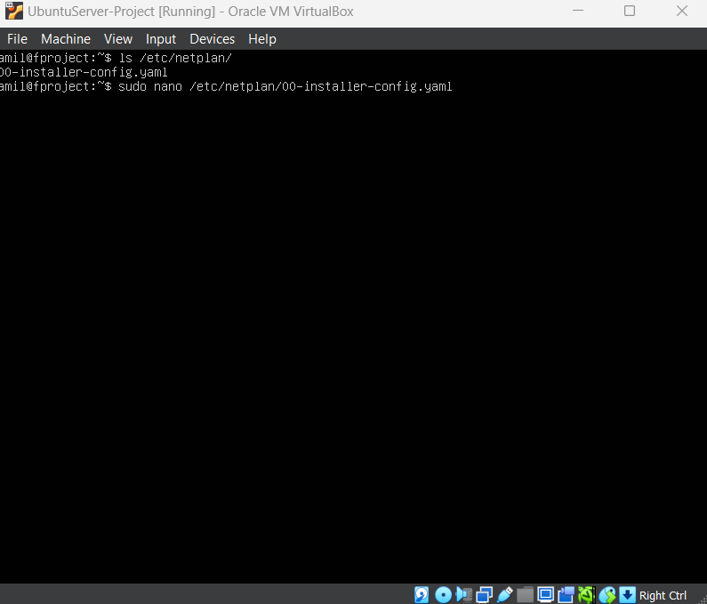
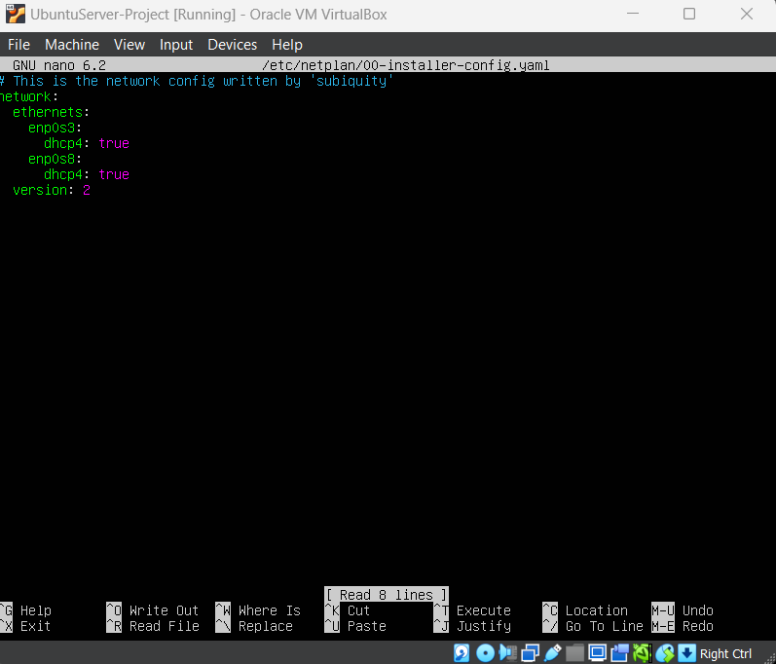

Slide 22
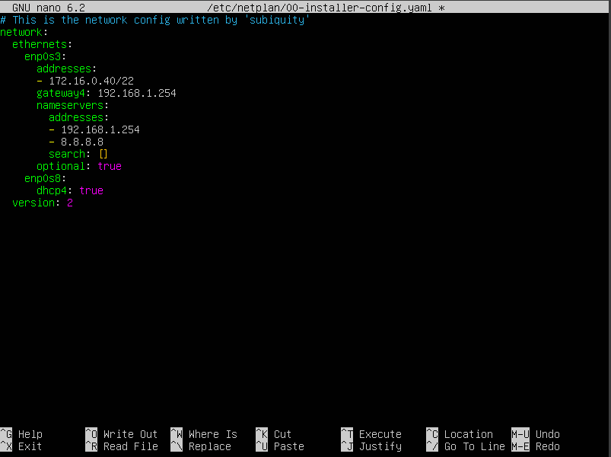
Some changes are being made to the network
172.16.0.0 – 172.31.255.255 B sinif şəbəkələr qrupundan
172.16.0.40 /22 static ip verilir.
Alt şəbəkə olaraq -- 255.255.252.0 (22) verilir.
(subnet)
DNS üçün
192.168.1.254
8.8.8.8

Slide 23
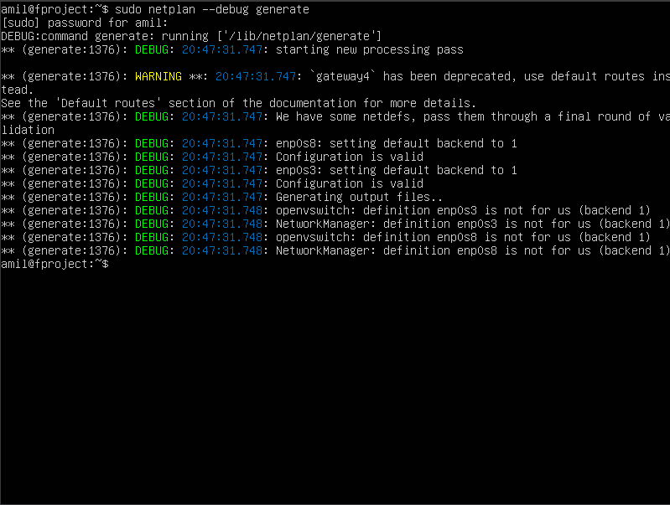
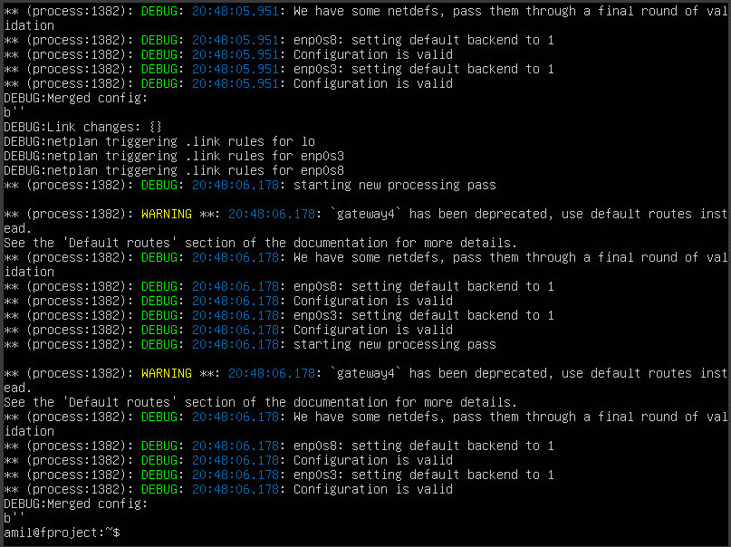

Slide 24
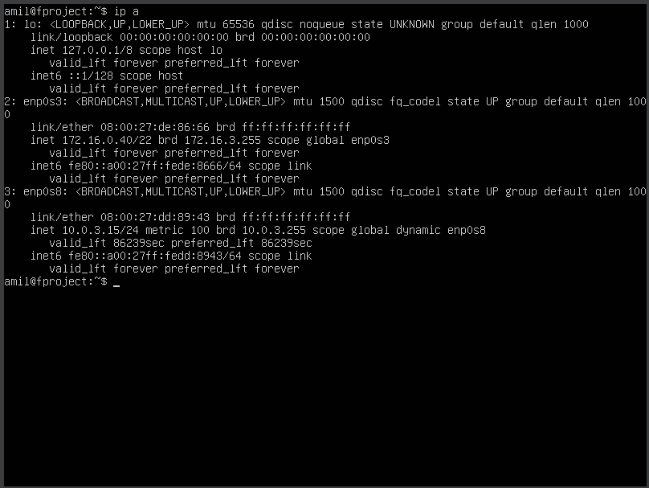

Slide 25
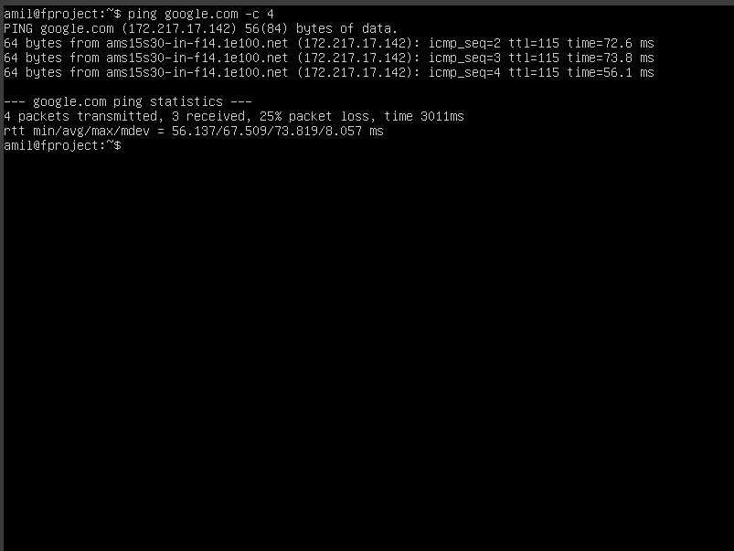

Slide 26
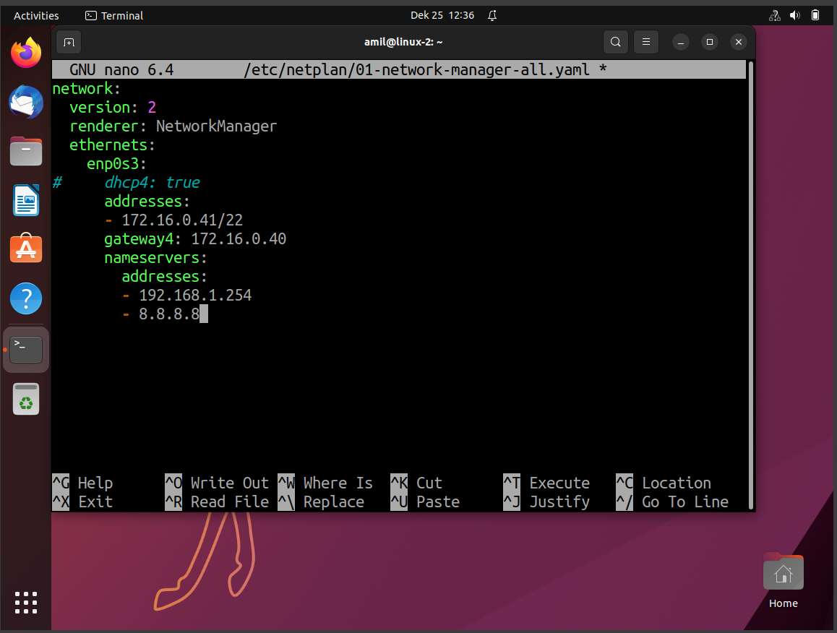
Network configuration process in Ubuntu Desktop

Slide 27
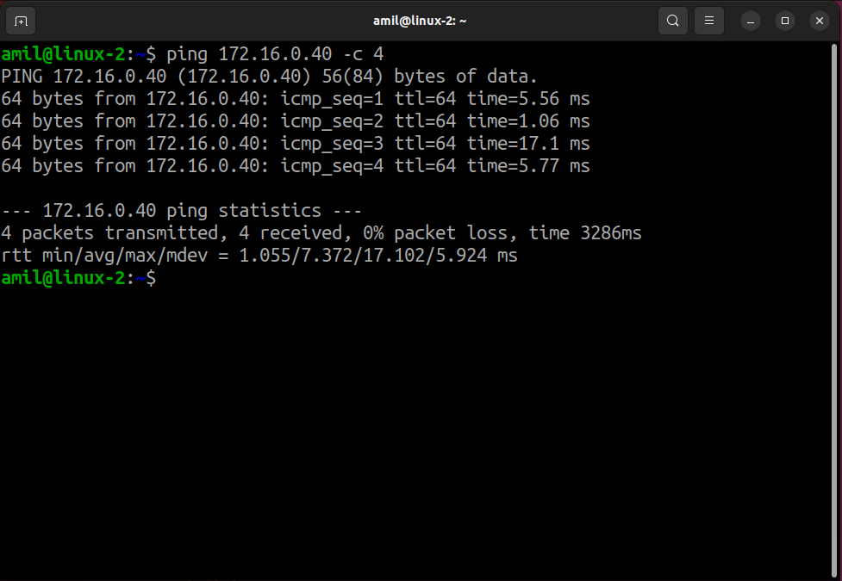

Slide 28
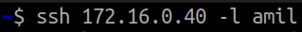
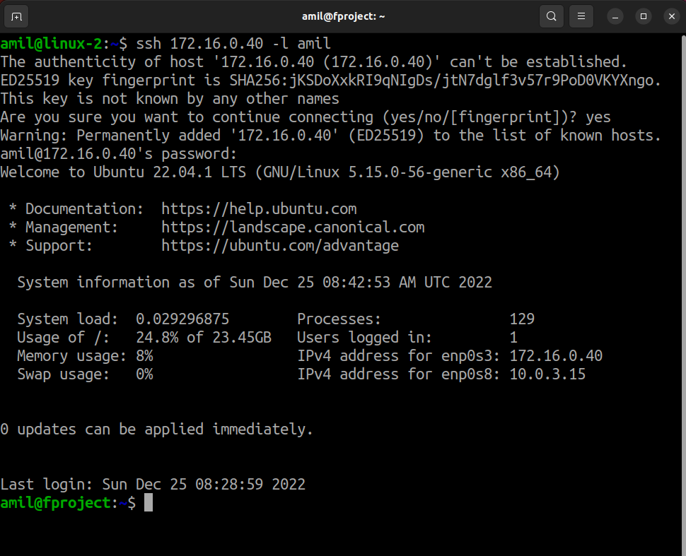
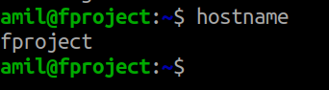
0011

Slide 29



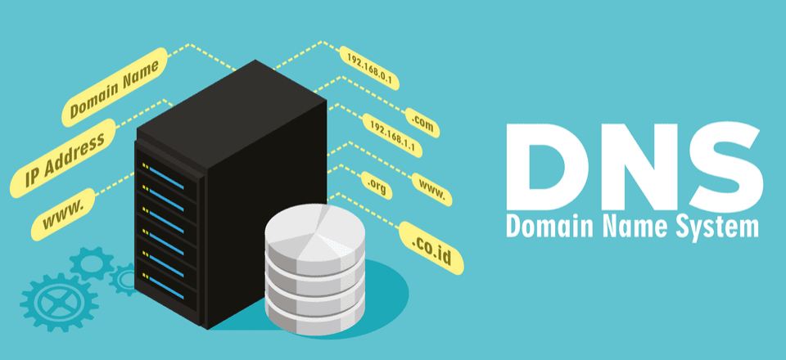

Slide 30
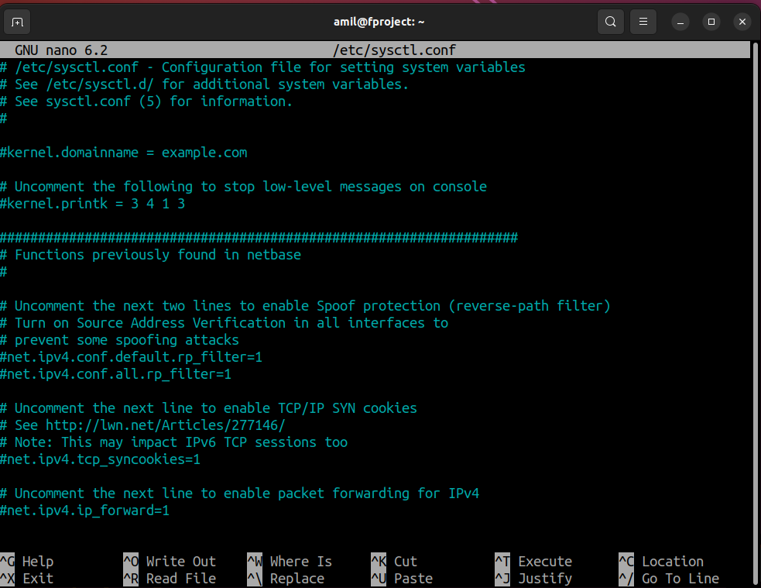
Installing Ubuntu Server for NAT
1) Using the sysctl tool

Slide 31
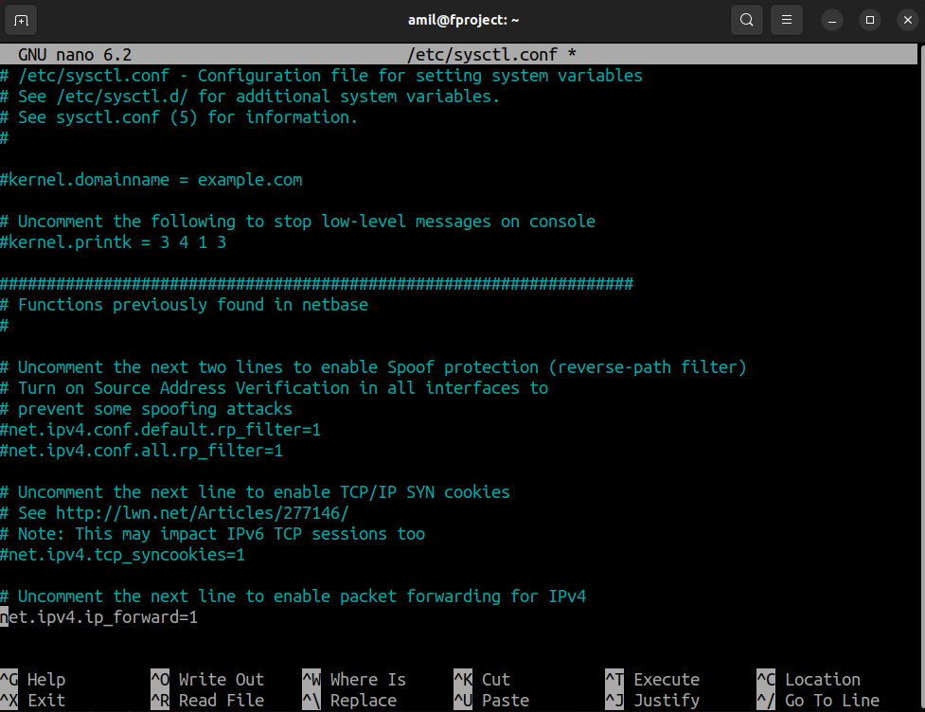
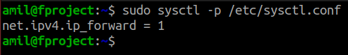

Slide 32
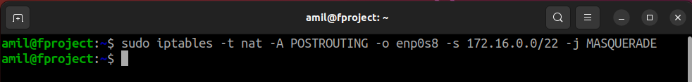
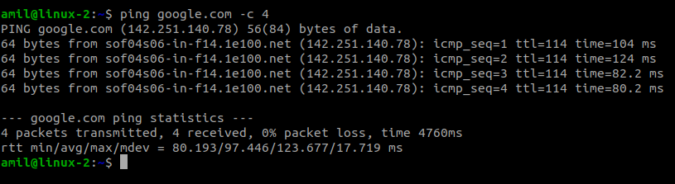
2) Applying the İptables tool
NAT funksiyasını Desktop Ubuntuda yoxlayaq :

Slide 33
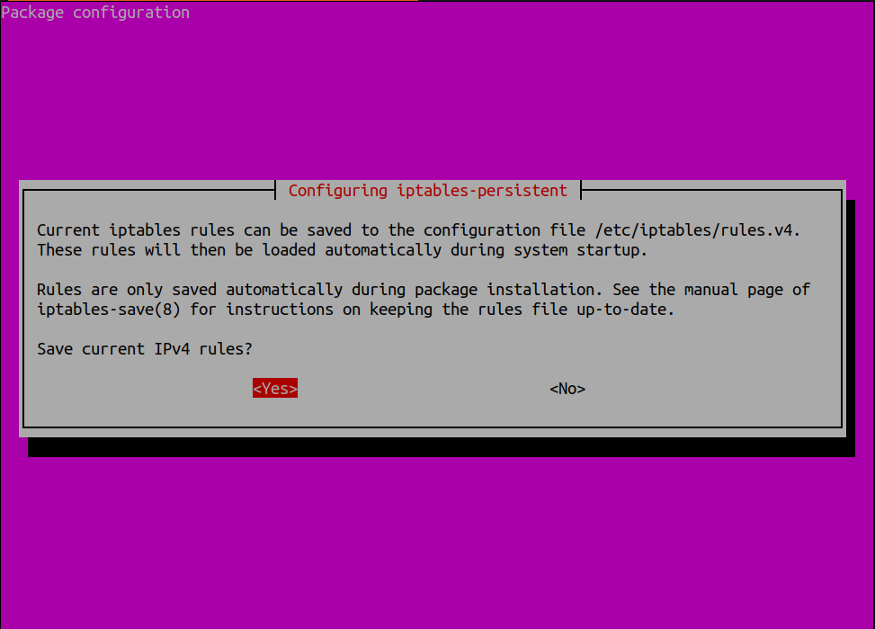
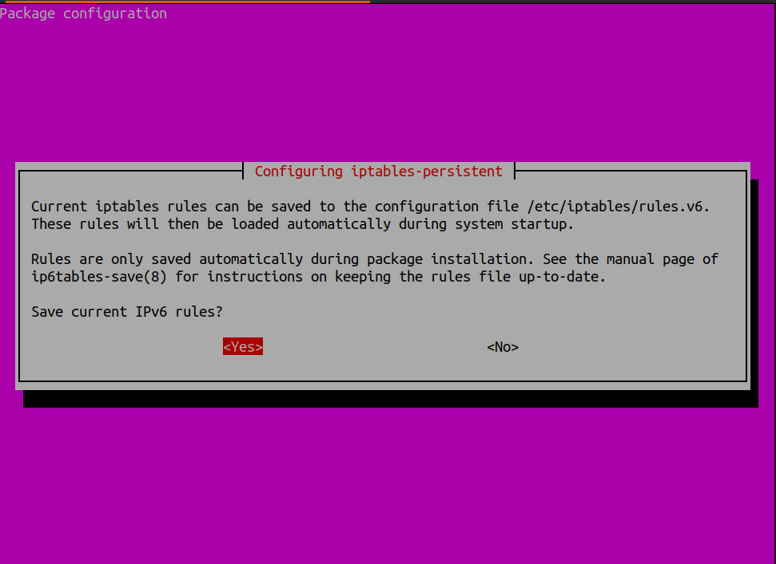
- Operation to save the given settings on the server

Slide 34
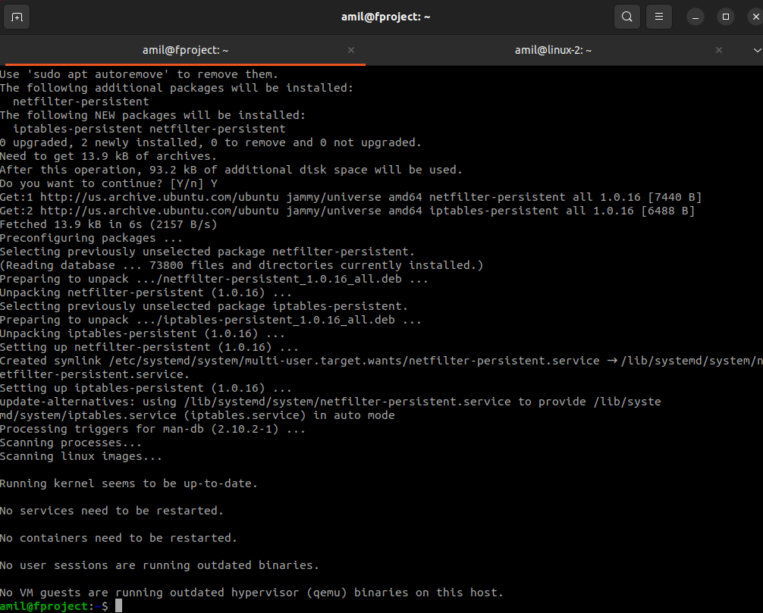

Slide 35
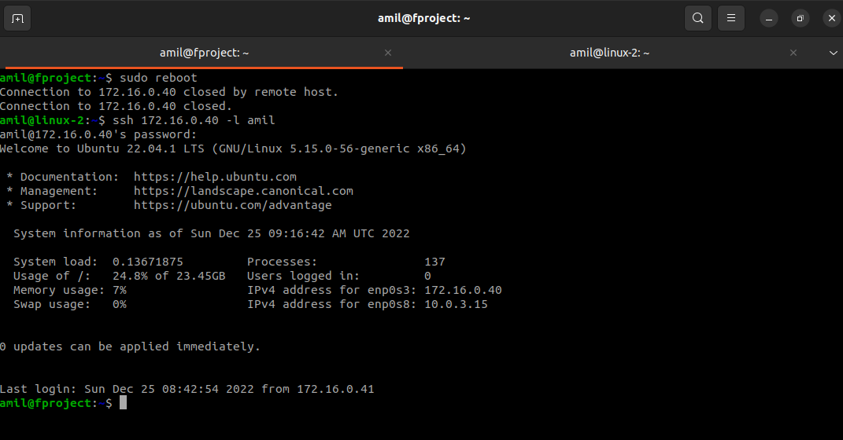

Slide 36
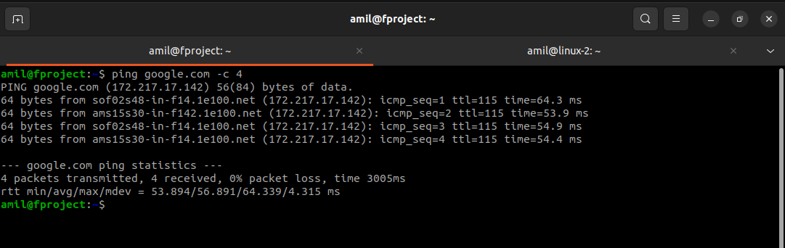

Slide 37
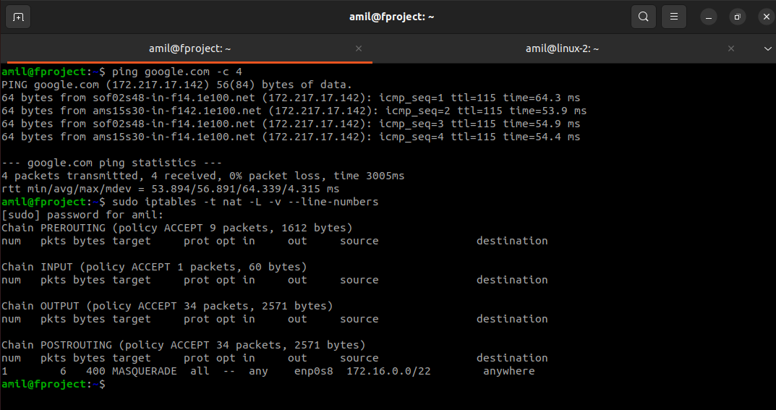

Slide 38
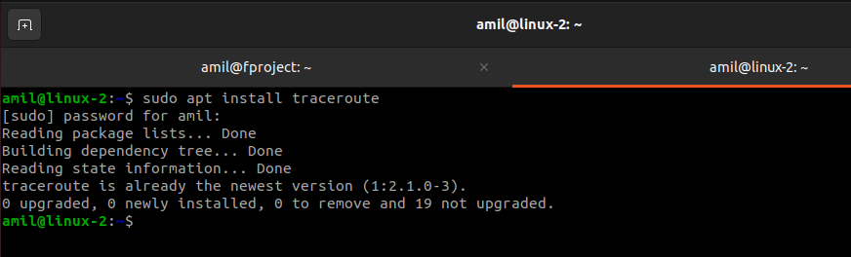
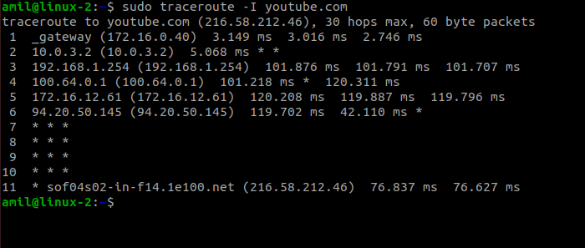
3) Applying the Traceroute tool
In Ubuntu Desktop we check:

Slide 39

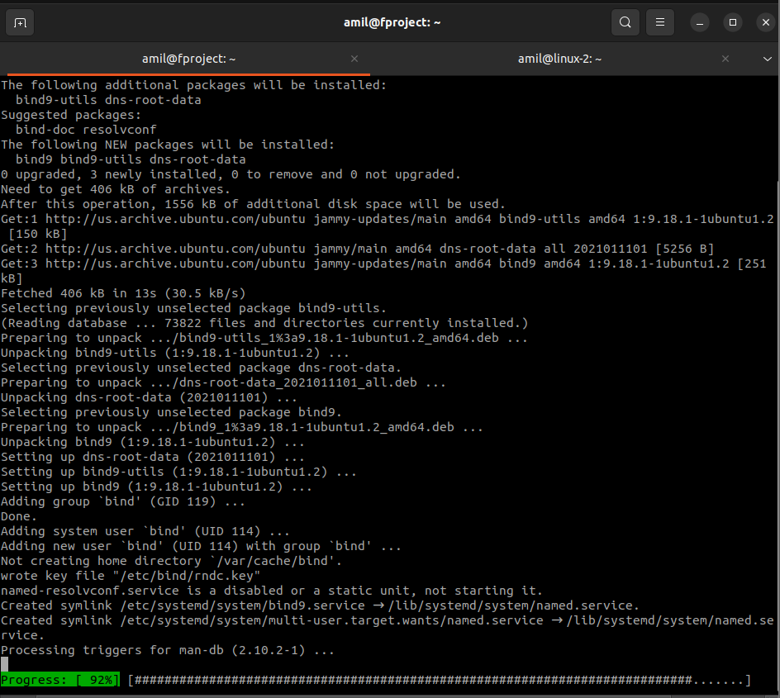
Initial configuration of DNS for Ubuntu Server
Bind9 – DNS server installation

Slide 40


Slide 41



Slide 42


Slide 43


DNS server setup for Ubuntu Desktop

Slide 44


Slide 45



Slide 46




Slide 47

Configuring a DHCP server for Ubuntu Desktop
1) Defining the network configuration
172.16.1.50 – 172.16.1.249
172.16.2.50 – 172.16.2.249
172.16.3.50 – 172.16.3.249
2)

Slide 48

3)

Slide 49


Slide 50


4)
5)

Slide 51


Obtaining an IP address for Ubuntu Desktop:

Slide 52



Slide 53

Testing the performance of ranges on the DHCP server

Slide 54


Slide 55



Slide 56

To restore the system to its previous state, the changes made during the process are reverted to their previous state.

Slide 57



Storage of IP addresses
Öncəliklə virtual maşının şəbəkə növü yoxlanılır :
1. VirtualBox ‘da quraşdırılmış “Ubuntu – Project” maşını seçir və ayarlar hissəsinə daxil oluruq :

Slide 58


Slide 59

IP address reserved by the DHCP server for the device's MAC address.

Slide 60


Slide 61


Slide 62

Installing Samba Domain Controller on Ubuntu Server

Slide 63

1) Updating the system, changing the name of the server, configuring the /etc/hosts file

Slide 64


sudo rm -rf etc/apt/sources.list
sudo software-properties-gtk

Slide 65



Slide 66

2) Setting the Bind9 DNS server to work with the domain controller

Slide 67



Slide 68


Slide 69



Slide 70


Slide 71


Disabling systemd-resolved service for DNS to work properly

Slide 72
System initialization for Samba Domain Controller is complete.

Slide 73

Installing and configuring the Domain Controller

Slide 74


Slide 75



Slide 76



Slide 77


Slide 78

- Renaming the Samba configuration file
- Domain Controller initialization
◘ Realm parametrinin yoxlanılması:
◘ Domain parametrinin yoxlanılması:

Slide 79



◘ Checking the Server Role setting:
◘ DNS backend parameter check: BIND9_DLZ must be entered
◘ Password for Domain Administrator is entered: s.Up.1md_

Slide 80


Slide 81


Checking samba version for Bind9:

Slide 82


Slide 83


Slide 84


Checking rights:

Slide 85

Downloading a list of root DNS servers:
Changing the permissions of the Named.root file:

Slide 86

Creation of Direct and Reverse viewing zones
Creating a master folder:
Creating a Live View Zone:

Slide 87


Changing zone rights:
Creating a counter view zone:

Slide 88



Changing zone rights:
Checking the DNS server configuration:
Restarting the DNS-server Bind9:

Slide 89

Final inspection of zones:

Slide 90

Starting Samba and adjusting the network configuration
To configure the operation:

Slide 91


Finally, checking the status of samba-ad-dc:

Slide 92

Network adjustment:

Slide 93


Slide 94




Slide 95


Copying the Kerberos setup:

Slide 96

Checking the configuration:

Slide 97


Slide 98

Joining a Domain Controller in Windows 10

Slide 99



Checking network settings:

Slide 100





Join the domain
s.Up.1md_

Slide 101



Slide 102


Slide 103


Installation of RSAT
RSAT – Remote Servers Administration Tools

Slide 104


Slide 105



Slide 106



Slide 107


Slide 108


Slide 109


Slide 110


Slide 111

Setting up an NFS Server
NFSv2 server is not supported:

Slide 112



Slide 113


rw – read / write
no_root_squash – "not crushing" the root authority of the host user

Slide 114


Slide 115

Setting up the NFS Client

Slide 116

Əlaqə uğurla yaradılmışdır.

Slide 117


Not testing the system:
Client tərəfdə testFile yaradılır:
Checking on the server:

Slide 118

Gnome Desktop Environment

Slide 119



Slide 120


Slide 121




Slide 122


Slide 123

Installation, configuration of the Docker Container platform on Ubuntu Server

Slide 124

Installing Docker, an OS-Level Virtualization Tool that automates the deployment of applications inside containers
[1] Downloading Docker

Slide 125



Slide 126


Slide 127


[2] Downloading the official image
Container creation
Removing the words [Welcome to Docker World] inside the container

Slide 128


Slide 129


[3] Connect to an interactive session of the container.
(Container process terminates if we exit the container session)
Kernel name – Linux. Host node name – ac1b00fc95e2. Kernel release – 5.15.0-56-generic. Kernel version and build time – #62-Ubuntu SMP Tue Nov 22 19:5414 UTC 2022 . x86_64 x86_64 x86_64 – Processor type, hardware platform and architecture of processor.
GNU/Linux – Operating system name.

Slide 130


Exit the container, provided the outgoing process is saved
(Ctrl+p) + (Ctrl+q)

Slide 131

Adding the Container images we created
For example, by installing Nginx, the official image is downloaded and added as a new image for the container. A container is created each time a docker run command is executed, so the most recently executed container is added as follows.
[1]
[2] Konteynerin işə salınması və nginx quraşdırılması
Problem: Sistem Xeta verir

Slide 132


Slide 133



Slide 134


Slide 135



Slide 136
Let's create a container from the new image and run the [which] command to make sure nginx is available:
Həqiqətən də:

Slide 137

Access to Container Services
Accessing services such as HTTP or SSH running as a daemon in containers:
start a Container and also run Nginx
map the port of Host and the port of Container with [-p xxx:xxx]
create a test page

Slide 138

Using DockerFile
Dockerfile usage and automatic creation of Docker images. Implementation of configuration management.
- As an example, the implementation of the Dockerfile creation process, where Apache2 is installed and started

Slide 139

build image ⇒ docker build -t [image name]:[tag] .

Slide 140



Slide 141

Using external memory
When containers are deleted, the data they contain is also deleted, so when needed, containers should use an external file system as persistent storage.
[1] Installing a directory into containers on Docker Host

Slide 142


[2] It is also possible to configure external storage with the Docker Data Volume command.
Volume [volume01] is created
display volume list (volume list)
Showing details of [volume01].

Slide 143

Start a container with a mount between [volume01] and [/mnt] on the container
It is also possible to install from other containers

Slide 144

To delete volumes, type:
If some containers are using the volume you want to delete as above, the target containers must be removed before deleting the volume.

Slide 145

Docker Network
Displaying the network list
Describing the details of [bridge].

Slide 146


Slide 147

[bridge] is set as container network by default

Slide 148



Slide 149

Creating a new network with [network01] and subnet [192.168.41.0/24]

Slide 150

Running a new container with [network02]

Slide 151
The process of connecting a network to a running container
(to attach the network to existing running container, set like follows)
Static IP
Container ID
Network

Slide 152

Process Error: There is no field named ip route in the system.

Slide 153


Slide 154


After the given problem is solved, the system starts working:

Slide 155

command
Checking for server:

Slide 156

Realization of the network disconnection process:

Slide 157

CODE FOR FUTURE
Thank You

